Slide 1

Mastering Git & GitHub
A Comprehensive Guide to Modern Source Control & Collaboration
$ git log --oneline --graph --all

Slide 2
Part 1: The Fundamentals
Understanding Version Control and Distributed Architecture

Slide 3



Git vs. GitHub: Architecture
Git (Local Tool)
GitHub (Platform)
A distributed version control system. It creates a complete copy of the project history on your local hardware. No internet required for daily tracking.
A cloud-hosting service for Git repositories. It provides an interface for code review, project management, and automated workflows.

Slide 4






The Three Pillars of a Git Project
Working Dir
Staging Area
Local Repo
Files you are currently editing. They are "untracked" or "modified" until you stage them for a snapshot.
A temporary prep area where you group related changes before committing. Think of it as a "pre-save" buffer.
The permanent history. Once committed, your snapshots are safely stored in the hidden .git directory.

Slide 5
Part 2: Recording Changes
Initialization, Staging, and Atomic Committing

Slide 6
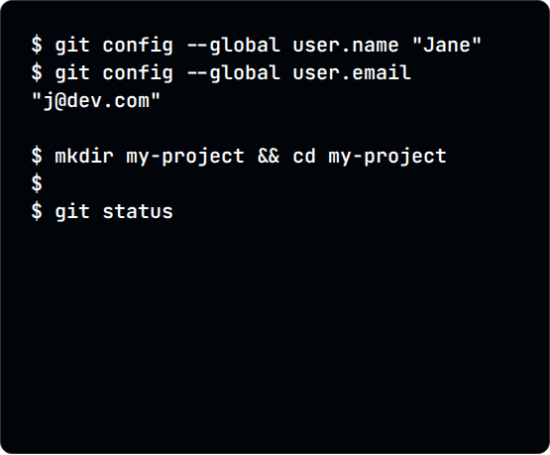
Setting Up Your Workspace
Identity: Set your name and email using --global config so your teammates know who wrote the code.
Initialization: Use git init to create a hidden .git folder that tracks every character you change.
git init
Inspection: Use git status religiously. It tells you exactly what is staged and what needs tracking.

Slide 7
The Professional Commit Cycle
Staging: Add specific files using git add [file] or group all using git add ..
Commit Message: Use the imperative mood. "Add login logic" instead of "Added login logic".
Atomic Commits: Keep one logic change per commit. Avoid "Fixed bug and updated CSS and deleted image".

Slide 8
Part 3: Branching & Flow
Parallel Development and Divergent History

Slide 9
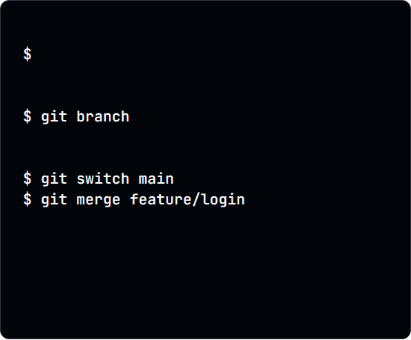
Strategic Parallel Development
Main Branch: Should always represent production-ready, stable code. Never work directly on Main.
# Create a new feature space
git switch -c feature/login
# List all branches
Feature Branches: Isolate new experiments. If they fail, you simply delete the branch without touching Main.
# Merge back to main
Safe Merging: Integrate your work back into the core project only after testing and review.

Slide 10
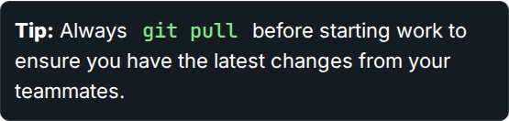
Collaborative Open Source Flow
Forking: Create your personal cloud copy of any public project.
Cloning: Bring that cloud copy to your local machine to start coding.
Pull Requests: Propose your changes to the original author. This is the heart of Open Source.

Slide 11
Part 4: Hands-on Lab

